Slide 1

ELECTION CAMP
SRM INSTITUTE OF SCIENCE AND TECHNOLOGY
FACULTY OF ENGINEERING AND TECHNOLOGY
DEPARTMENT OF NETWORKING AND COMMUNICATIONS
18CSS101J- MINI PROJECT
Shashwat Verma [RA2111028010136]
Vansh Pitalia [RA2111028010129]
Arihant Agarwal [RA2111028010120]
Aum Padhi [RA2111028010197]
Branch : CSE with Specialization in Cloud Computing
Section : K2
Lab Instructor name : Mr.J.Prabakaran

Slide 2
Table of contents
Introduction
Algorithm
Flowchart
Results and Explanation
References

Slide 3
Introduction

Slide 4
Topic
Election Camp

Slide 5
Aim
To create a voting and polling system which allows easy elections and declares the winner and the name of the party as well as the number of seats or votes.
To create a voting and polling system which allows easy elections and declares the winner and the name of the party as well as the number of seats or votes.

Slide 6
Algorithm

Slide 7
Algorithm
Step – 1 : Start
Step – 2 : Define all the variables used in the program i.e. The names of the candidates along with the name of parties.
Step – 3 : Create an integer type for vote count.
Step – 4 : Display opening window using printf with names of all candidates .
Step – 5 : Take input from the user from the above options
Step – 6 : The choice of the user will be saved and reflected in the chosen candidate by switch case.

Slide 8
Algorithm
Step – 7 : Vote count to be accessed through menu after voting which will display the name of the candidate along with number of votes.
Step – 8 : Leading candidate will be displayed using the get function
Step – 9 : Starting window to have options to retrieve whichever data is required such as:-
Step – 9.1 : Cast vote
Step – 9.2 : Votes count
Step – 9.3 : Leading candidate
Step – 9.4 : Exit program
Step – 10 : Display error when the input doesn’t match the required data type or given conditions .
Step – 11 : End

Slide 9
Flowchart

Slide 10
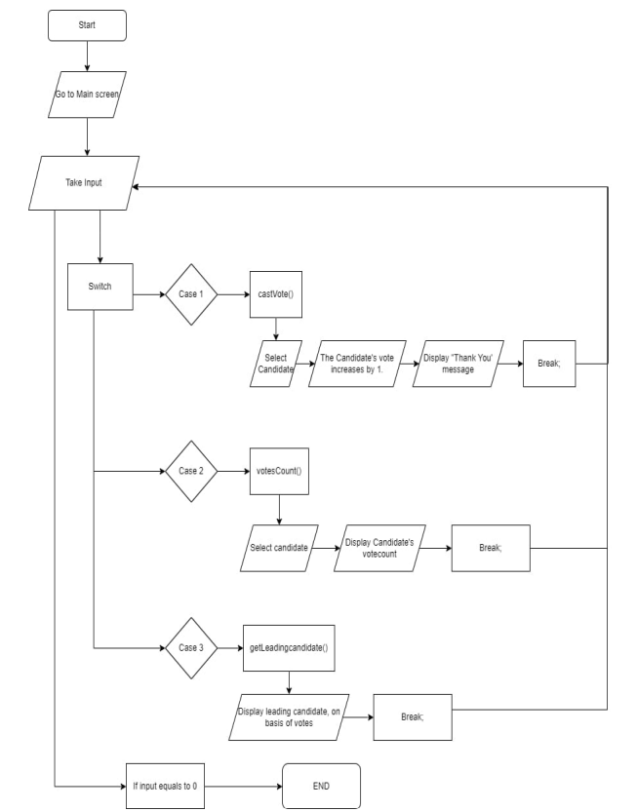
Flowchart
For New Entry
Start
Enter the value in structure array
Display Entered values
Yes
For more entry
No
Stop

Slide 11
Result & Explanation

Slide 12
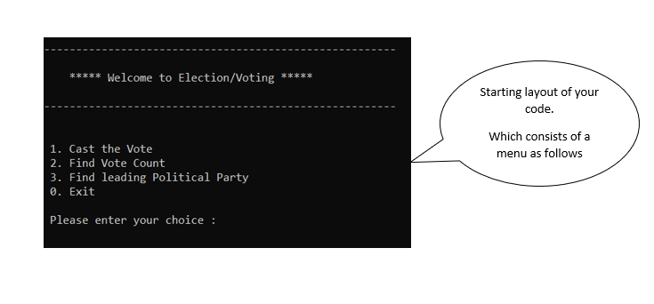
Result & Explanation

Slide 13
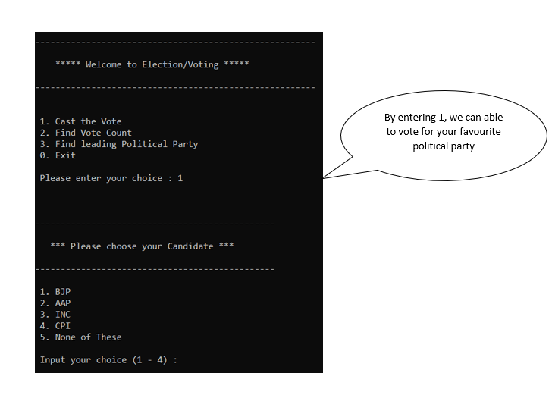
Result & Explanation

Slide 14
Result & Explanation

Slide 15
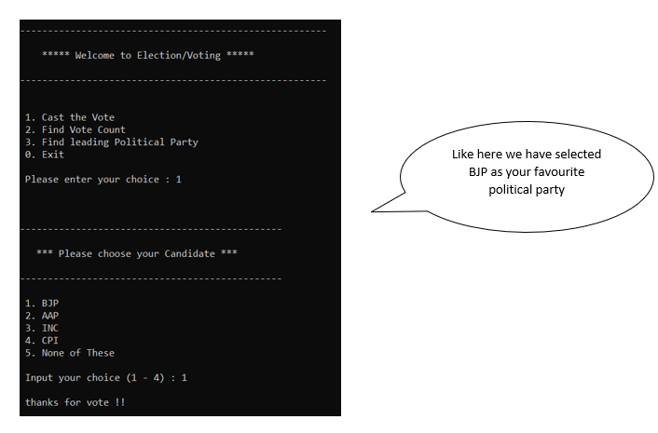
Result & Explanation

Slide 16
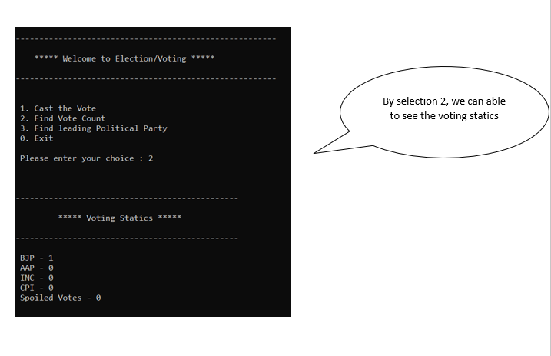
Result & Explanation

Slide 17
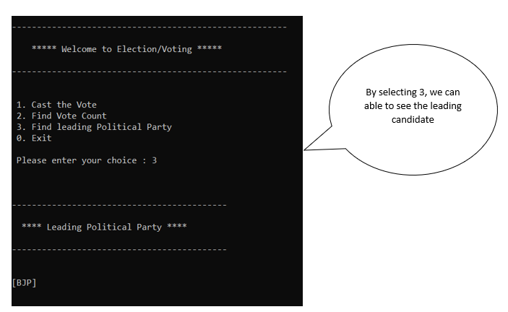
Result & Explanation

Slide 18
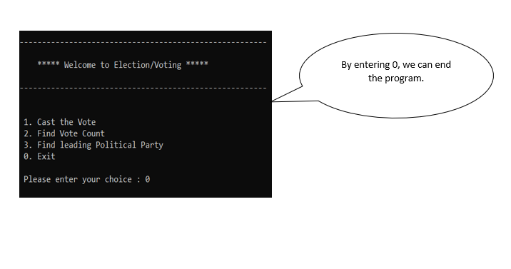
Result & Explanation

Slide 19
Software Requirements

Slide 20
Software Requirements
Ram – 8GB
SSD – 1TB
Processor – i7 intel core
Generation – 11th gen
Operating System – Window / IOS
Compiler – Code Block / VS Code

Slide 21
References

Slide 22
References
CodeChef
JavaTpoint
W3 School
Greekworld
VS Code
Code Block

Slide 23
Thanks

